Slide 1
Java Exception
Author: Nguyen Thanh Hien
Date: 3-2016
Contact: hien.nt@tctav.com

Slide 2
Leaning goals:
Get to know what’s Exception
Using Exception to handle errors

Slide 3
Table of contents:
What’s exception
Exception hierarchy
Handle Exception: Using throws and throw
Check vs Uncheck Exception
Exception classes

Slide 4
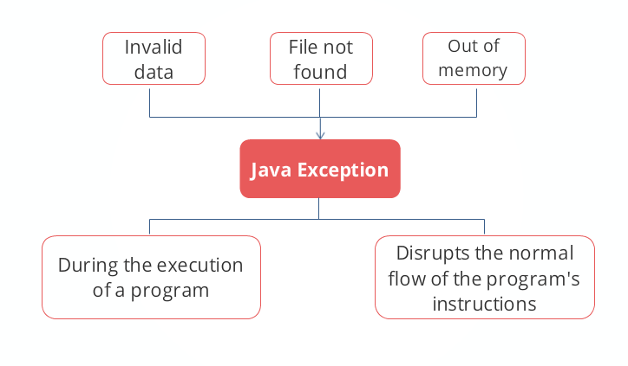
What is Exception:

Slide 5
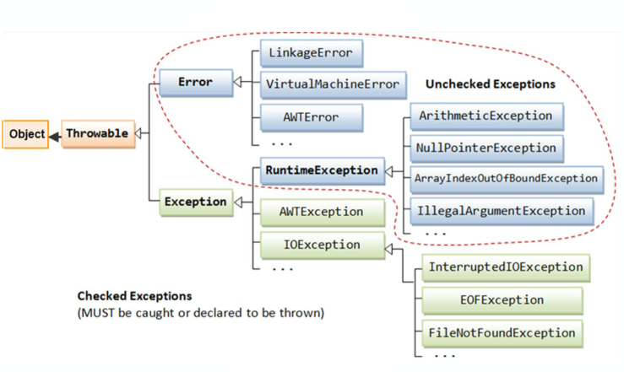
Hierarchy Exception:

Slide 6
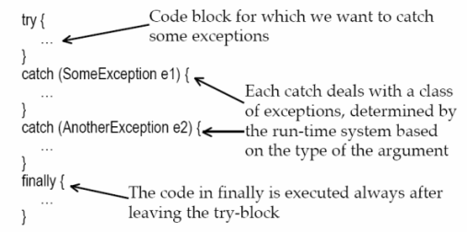
Handle Exception: Try-Catch-Finally (1)
Structure: Try-Catch-Finally.

Slide 7
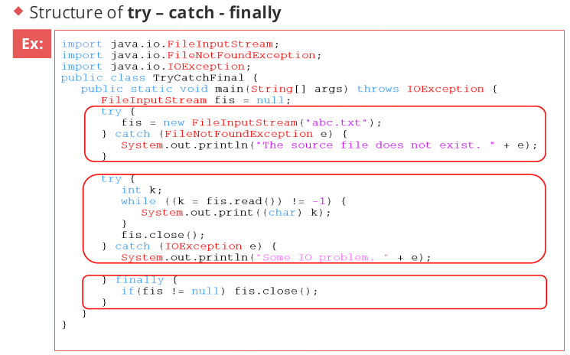
Handle Exception: Try-Catch-Finally (2)
Ex:

Slide 8
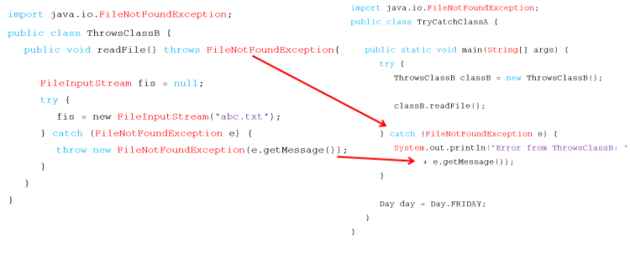
Handle Exception: Throws and Throw
“Throw” keyword: is used to throw an exception
“Throws” keyword: class calling that method gets a prior knowledge about which exception to handle of method from other class

Slide 9
Checked And Unchecked Exception:

Slide 10
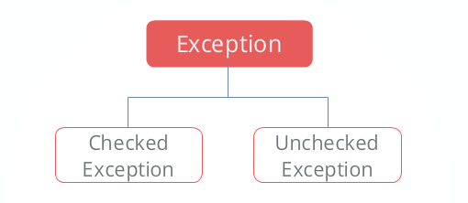
Checked And Unchecked Exception:
Check Exception in java is all those Exception which requires being catches and handle during compile time. Checked Exception in Java extend the java.lang.Exception class | Uncheck Exception: in Java is all those Exceptions whose handling is not verified during compile time. Unchecked Exception in java extend the java.lang.RuntimeException class.

Slide 11
Exception classes:
7 classes extend Exception class:
ClassNotFoundException.
RuntimeException.
CloneNotSupportException.
IllegalAccessException.
InstantiationException.
InterruptedException.
NoSuchMethodException.
4 classes extend Error class:
LinkageError.
ThreadDeath.
VirtualMachineError.
AWTError.

Slide 12
Summary
What’s Exception: An exception is an event that disrupts the normal flow of the program instructions.
Exception hierarchy: 2 class Exception & Error extend Throwable.
Handle Exception: try-catch-finally, using throws and throw
Checked vs Unchecked Exceptions:
Checked Exception: in Java extend the java.lang.Exception class.
Unchecked Exception extend java.lang.RuntimeException.
Exception class.

Slide 13
The End
Author: Nguyen Thanh Hien
Date: 5-2016
Contact: hien.nt@tctav.com
Thank you for listening

